Slide 1
Hello Everyone Project Name : Helicopter War Course Code : CSE178
Project Supervisor:
MD Nesarul Hoque
Assistant Professor
Department of CSE,BSMRSTU
Gopalganj-8100.
Submitted By:
MD. Imran Hosen
Student ID: 18CSE019
Department of CSE,BSMRSTU
Gopalganj-8100.

Slide 2
Presentation Outline
Introduction of Project
Playing process the Helicopter War game
Features
Some Snapshots
Results & Evaluations
Future scope of the program

Slide 3
Introduction
The Helicopter War is 2D action game. It will be enjoyable for kid and younger.
There has single and multiple mode in this game. And now a day multiple mode is more popular than single mode game.
Single mode game has two level so its more hard when player going to second level.
This game graphics is all most good .

Slide 4
Playing process the Helicopter War Game
Single play
Multiple play

Slide 5
Features
The frame for this game will be 1400* 600 in size.
In single play mode have two level
First level has one enemy helicopter and two enemy tank and second level has one helicopter and two ship.
Multiple mode can play two player .
Which player first damage another player he will win.
There has also Sound in this game. Menu and game sound are deferent.
In single play mode you cant finished this game.

Slide 6
Some Snapshots
iGraphics Function
Main function
First Look of function
After start game.
Single play 1st and 2nd level
Multiple play
When game will over

Slide 7
IGraphics Function
IGraphics file
IGraphics Function work
IGraphics main function
IGraphics picture work

Slide 8
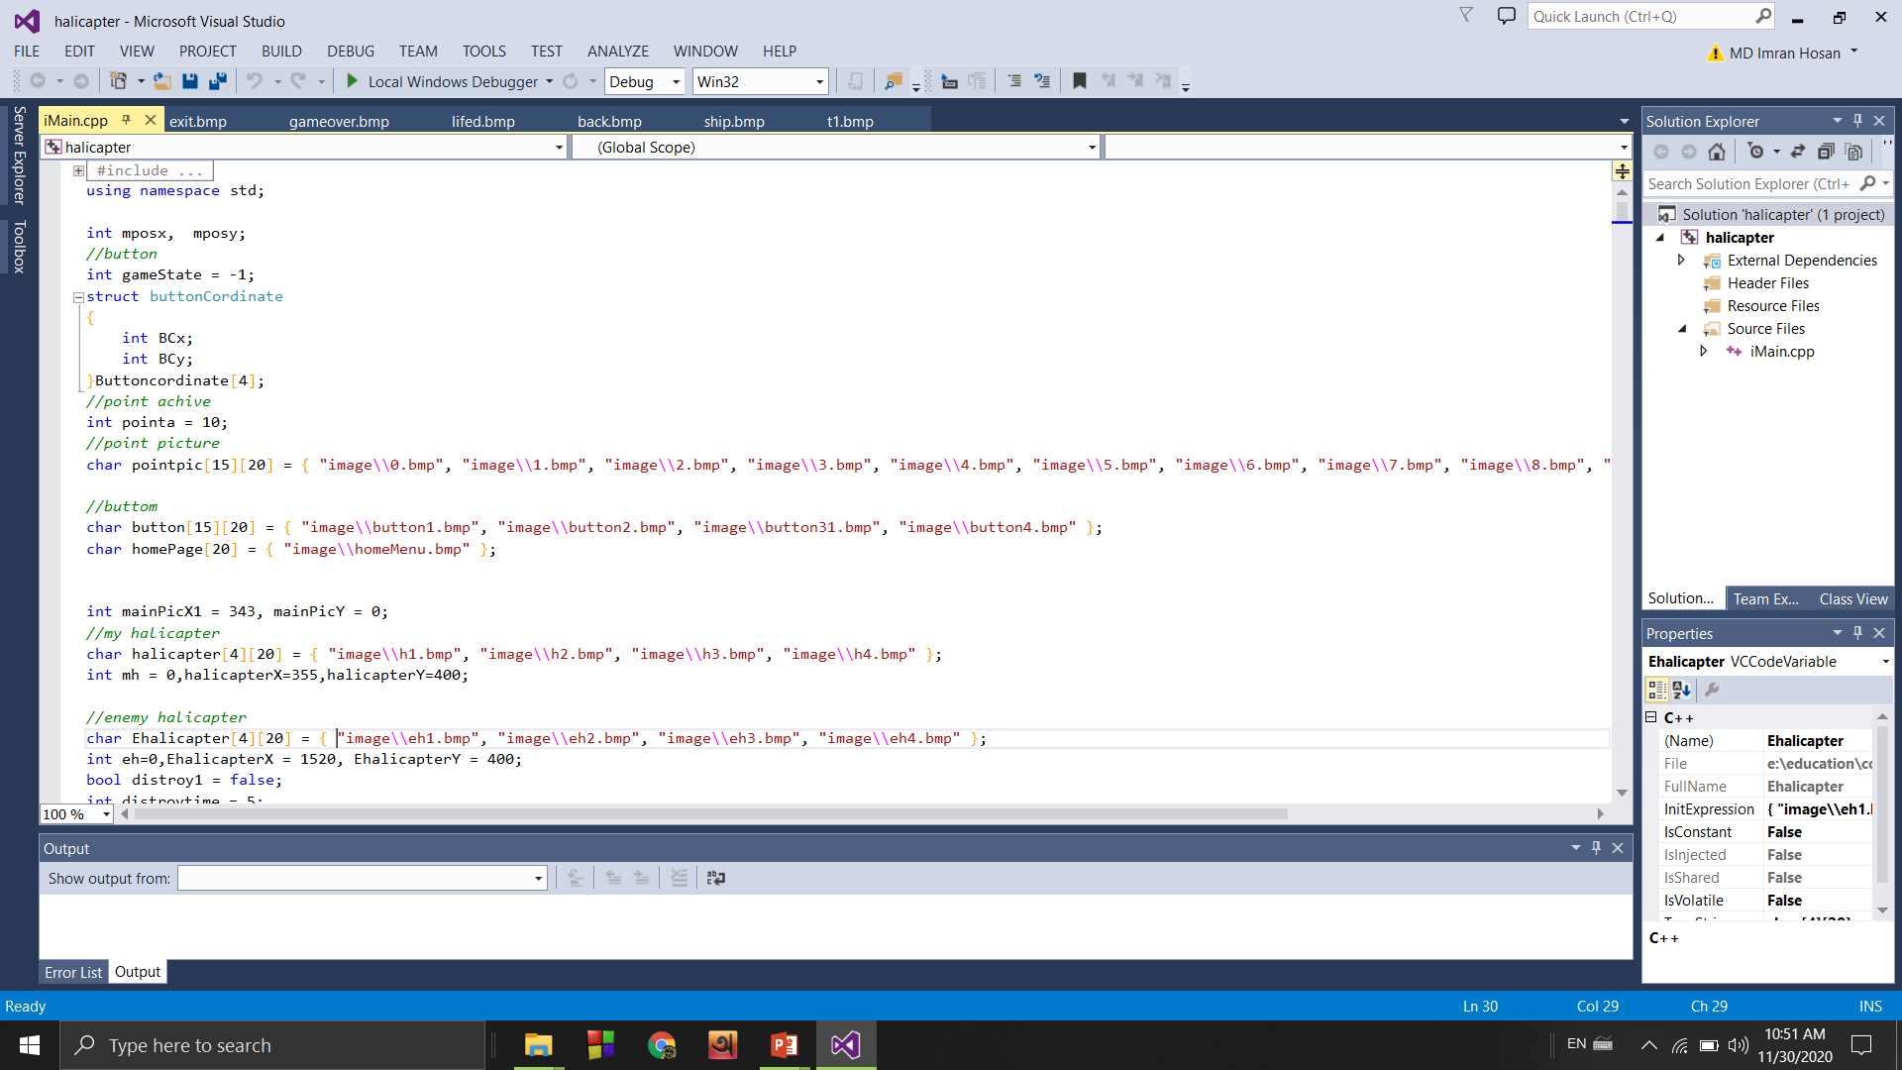
Igraphiics file

Slide 9
Igraphics Function Work
iDraw-Function iDraw() is called again and again by the system & drawing codes here
iClear-Function iClear() is called again and again by the system & clear console.
iMouseMove-Function iMouseMove() is called when the user poesses and dregs the mouse(mx,my)is the position where the mouse pointer is.
iKeybord-Function iKeyboard () is called whenever the user hits a key in keyboard key –holds the ASCII or special keyboard of the key pressed.
iMusic-Function iMusic() is called whenever music need in game .

Slide 10
IGraphics Main Function
int main()
{
//for button
int sum = 50;
for (int i = 3; i >= 0; i--)
{
Buttoncordinate[i].BCx = 50;
Buttoncordinate[i].BCy = sum;
sum += 130;
}
iInitialize(1400, 600, "Imran");
return 0;
}
The main () function as a built-in function.

Slide 11
Igraphics Picture Works
iGraphics support only BMP format pictures.
iShowBMP()-This function help to show picture in console.
iShowBMP()-This function almost like iShowBMP function but we can remove some color from picture by this function

Slide 12
First Look of My Program

Slide 13
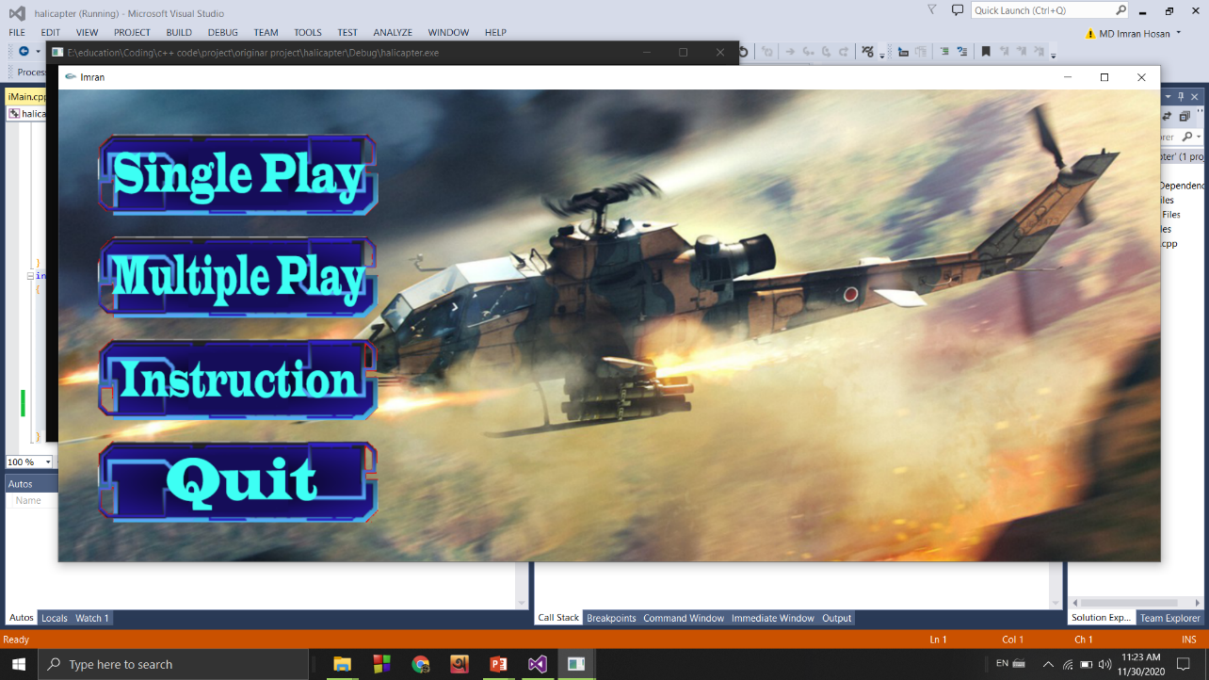
After Start Game

Slide 14
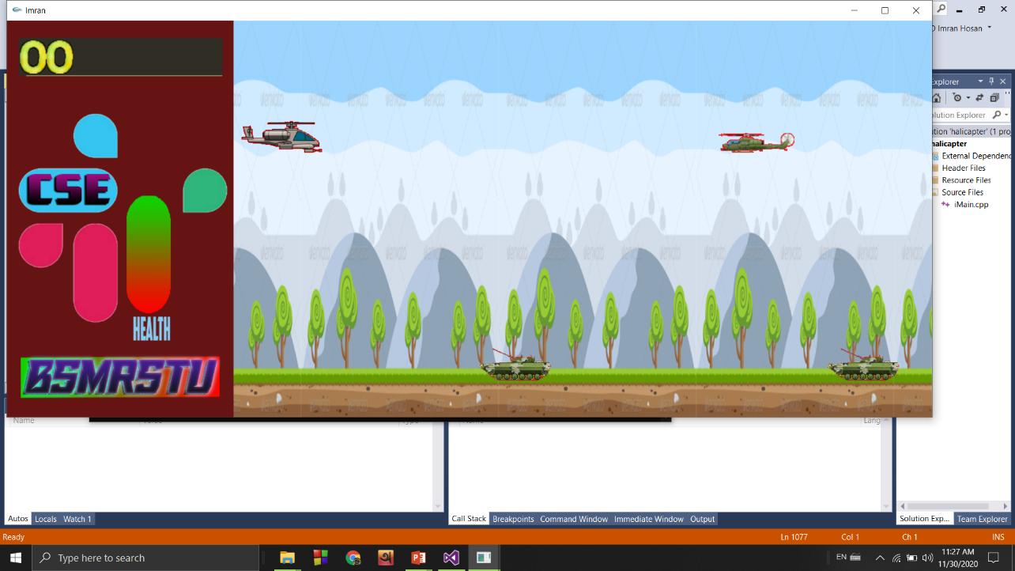
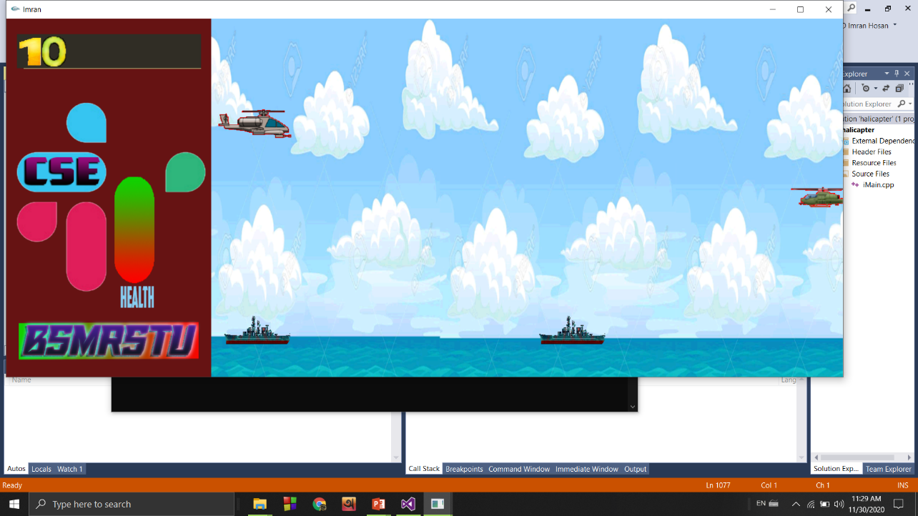
Single Play 1st And 2nd Level

Slide 15
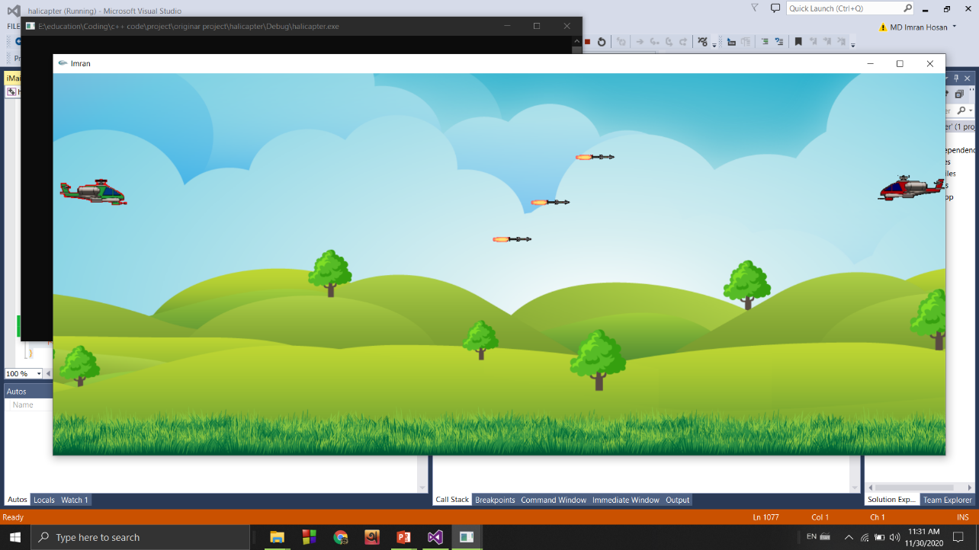
Multiple play

Slide 16
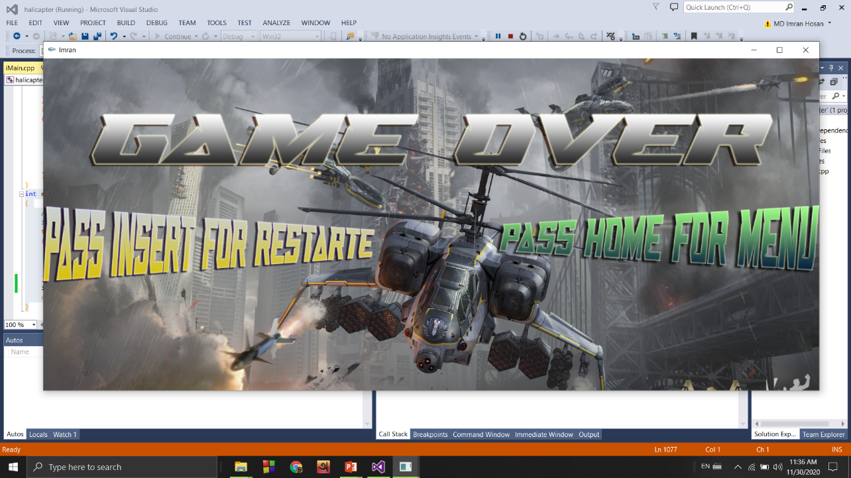
When Game Will Over

Slide 17
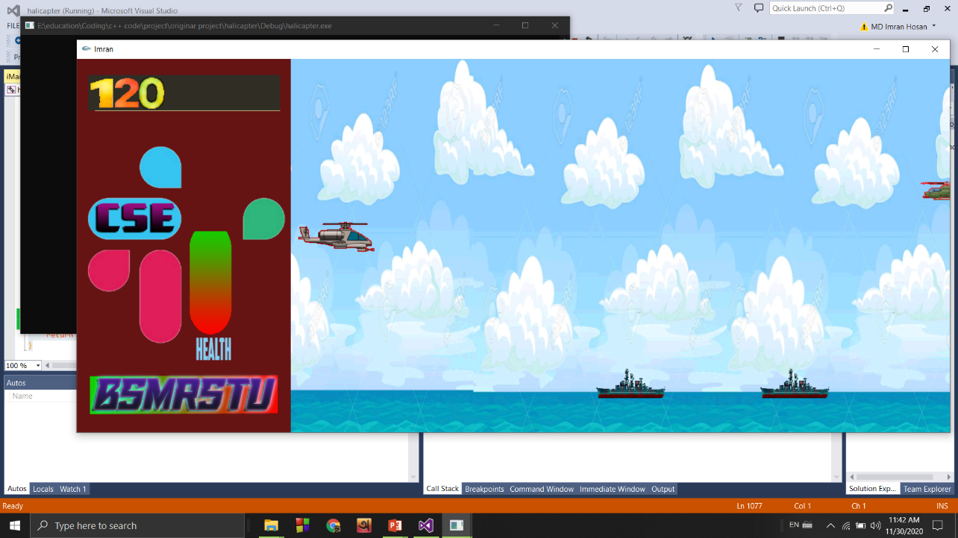
Results & Evaluations

Slide 18
Future Scope of the Program
Leaderboard
Stage levels or game levels increase.
More graphics.
Difficulty level increase.

Slide 19
Thanks All

